Slide 2
Digital Forensics Lecture-18
By- Dr.subhranil Das
Assistant Professor
School of computer Science

Slide 3

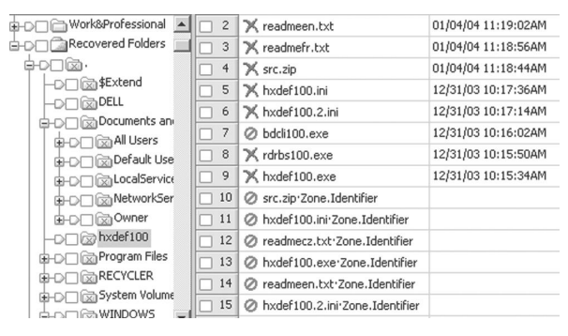
Prior folder structure recovered from a reformatted NTFS volume

Slide 4
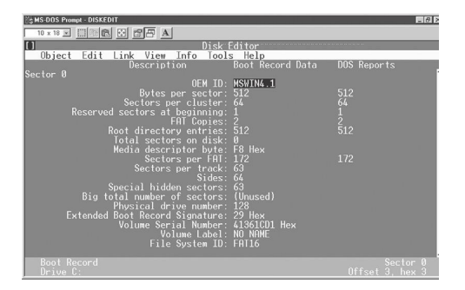
Windows 95 boot sector viewed using Norton Diskedit

Slide 5
Explanation
The first sector on each volume, called the boot sector (a.k.a. boot record or boot block), contains important file system information.
It shows that two copies of the file allocation table (FAT) are available—this table is the equivalent of the library card catalog and a backup copy is maintained in case the primary one is damaged or destroyed.
Each cluster on the disk is quite large (64 sectors/cluster × 512 bytes/sector = 32 kbytes).

Slide 6
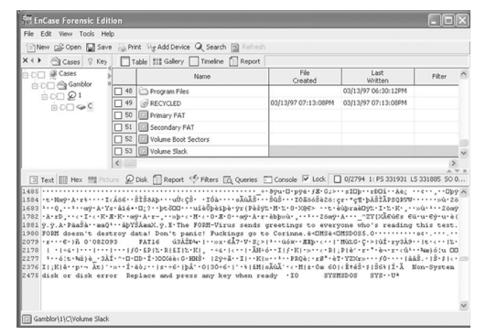
Volume slack containing remnants of Form virus viewed using EnCase
Be aware that a file system may not use an entire partition, leaving space between the end of the volume and the end of the partition, an area called volume slack that can be used to hide data.

Slide 7
Several Features of file systems
1. When a file takes up less than one cluster, other files will not use the additional space in that cluster..
2. If a computer tried to squeeze extra data into the unused part of a cluster, the new data might interfere with the old.
3. The extra sectors in a cluster are called file slack space.
4. When a file does not end on a sector boundary, operating systems prior to Windows 95a fill the rest of the sector with data from RAM, giving it the name RAM slack. Later versions of Windows fill this space with zeros.

Slide 8
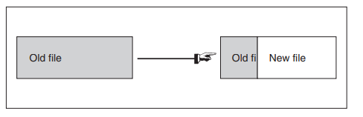
Several Features of file systems
5. When a file is deleted, its entry in the file system is updated to indicate its deleted status and the clusters that were previously allocated to storing are unallocated and can be reused to store a new file.
6. The data are left on the disk and it is often possible to retrieve a file immediately after it has been deleted. The data will remain on the disk until a new file overwrites them.
7. If the new file does not take up the entire cluster, a portion of the old file might remain in the slack space. In this case, a portion of a file can be retrieved long after it has been deleted and partially overwritten.

Slide 9
Dealing With Password Protection
Password protection is often the more straightforward challenge where it is acceptable for a digital evidence examiner to overcome password protection on individual files found on a computer he/ she is analyzing.
A variety of tools are available for obtaining, circumventing, or guessing passwords on different file types.
Two of the most powerful and versatile password recovery programs currently available are the Password Recovery Toolkit (PRTK) and DNA from Access Data.
The PRTK can recover passwords from many file types and is useful for dealing with encrypted data. It is also possible for a DNA network to try every key in less time by combining the power of several computers.

Slide 10
Dealing With Password Protection
There are other more specialized password recovery tools such as John the Ripper (http://www.openwall.com/john/), Cain and Abel (http://www.oxid.it/cain.html), and Advanced Archive Password Recovery (http://www.elcomsoft.com/azpr.html).
When performing a functional reconstruction using a restored clone of a Windows system, it may be necessary to bypass the logon password using a program
like ntpasswd (http://pogostick .net/~pnh/ntpasswd/) or Microsoft’s ERD Commander.

Slide 11
Encryption
Encryption is a process by which a readable digital object (plaintext) is converted into an unreadable digital object (ciphertext) using a mathematical function.
Strong encryption schemes use the equivalent of a password, called a key. However, there are simple, keyless encoding systems.
ROT13 is a simple code that substitutes each letter in the plaintext message with the letter that is 13 letters farther along in the alphabet (A is followed by Z). So, a becomes n, b becomes o, etc. ROT13 is commonly used in newsgroups to obfuscate potentially objectionable messages, allowing the reader to decide whether to decrypt the message. The following Usenet message demonstrates this application of ROT13.

Slide 12
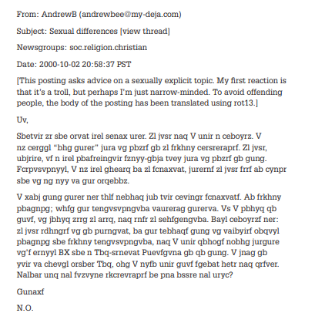
Example of Encryption

Slide 13
Private Key encryption
Private key encryption is used to encrypt a message is also used to decrypt it.
Thinking of encryption as a lock, the same key that locks the data is used to unlock it and, without the key, it is very difficult to unlock the data.
The “lock” is a mathematical function. As it is not safe to rely on the secrecy of the mathematical function used to encrypt the data, most popular encryption schemes utilize mathematical functions that are difficult to reverse.
Some commonly used symmetric key encryption algorithms are DES, IDEA, and Blowfish. For example, taking the text “This is a secret message” and encrypting it using the key “eoghan” and the DES algorithm gives the following ciphertext

Slide 14
Public Key Encryption
Problem: One of the main difficulties with symmetric key encryption arises when people want to encrypt their communications. Both people must have the key that encodes and decodes the data.
For instance, if two people want to exchange encrypted e-mail, how do they exchange the key to decrypt the message? Should they send the key in one message and then the encrypted data separately?
The answer to public key encryption. In the 1970’s, clever mathematicians finally developed a mechanism to implement this idea, allowing an individual to disseminate a piece of information called a public key that anyone could use to encrypt a message and only the intended recipient who possessed the corresponding private key could decrypt the message.
Two commonly used public key algorithms are RSA and DSA

Slide 15
Pretty Good Accuracy (PGP)
One program that uses both private and public key cryptography is Pretty Good Privacy (PGP; www.pgpi.com).
Uses a public key algorithm like RSA to encrypt messages, this would be slow when dealing with large messages. Private key encryption is significantly more efficient.
PGP took the best of both methods and combined them.
PGP encrypts a message using a private key algorithm like DES using a randomly generated private key and encrypts the private key using a public key algorithm like RSA (this step requires the intended recipient’s public key).
PGP then sends both the encrypted text and the encrypted private key to the recipient. Thus, when the recipient receives the encrypted message, he/she uses his/her personal private key to decrypt the randomly generated private key and uses the randomly generated private key to decrypt the message.

Slide 16
Next Lecture
Digital Evidences in Windows System
.

